Slide 1
Transmathematical Basis
of Infinitely Scalable
Pipeline Machines
Dr James Anderson FBCS CITP CSci

Slide 2
Agenda
Totallity + known waiting time = perfect pipeline concurrency
Pipelines deliver energy efficiency and unlimited scalability with constant computational efficiency
Demonstration
Transmathematics delivers totality
Summary

Slide 3
Definitions
Totallity - A total function gives a valid result in its output class when applied to any arguments in its input class
Waiting time - The time an algorithm takes to complete

Slide 4
Perfect Concurrency

Slide 5
Concurrency
Parallelism minimises latency
Pipelining maximises concurrency

Slide 6
Von Neumann Program
Instruction 1
Data 1
Instruction 2
Instruction 3
Instruction n

Slide 7
Von Neumann Program
Instruction 1
Instruction 2
Data 1
Instruction 3
Instruction n

Slide 8
Von Neumann Program
Instruction 1
Instruction 2
Instruction 3
Data 1
Instruction n

Slide 9
Von Neumann Program
Instruction 1
Instruction 2
Instruction 3
Instruction n
Data 1

Slide 10
Pipeline Program
Instruction 1
Data 1
Instruction 2
Instruction 3
Instruction n

Slide 11
Pipeline Program
Instruction 1
Data 2
Instruction 2
Data 1
Instruction 3
Instruction n

Slide 12
Pipeline Program
Instruction 1
Data 3
Instruction 2
Data 2
Instruction 3
Data 1
Instruction n

Slide 13
Pipeline Program
Instruction 1
Data n
Instruction 2
Data 3
Instruction 3
Data 2
Instruction n
Data 1

Slide 14
Pipeline Program
Instruction 1
Instruction 2
Data n
Instruction 3
Data 3
Instruction n
Data 2

Slide 15
Pipeline Program
Instruction 1
Instruction 2
Instruction 3
Data n
Instruction n
Data 3

Slide 16
Pipeline Program
Instruction 1
Instruction 2
Instruction 3
Instruction n
Data n

Slide 17
Pipeline Machine
Throughput is independent of program length
Data concurrency increases with program length
The bigger the program, the faster it is - relative to a von-Neumann-core machine

Slide 18
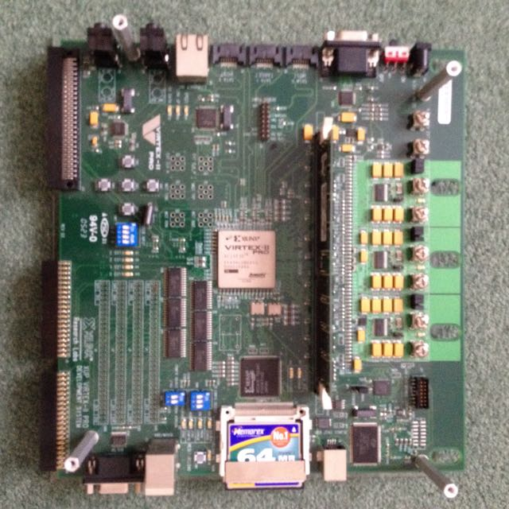
FPGA Prototype

Slide 19
Architectural Prototype
Token = 16 bit header + 80 bit float datum
64 k cores per chip
2 M cores per board
16 M cores per cabinet
20 kW per unweighted PWFLOP

Slide 20
Relative Addressing
Fixed size, relative address implements an address horizon in an arbitrarily large machine and maintains constant computational efficiency regardless of the size of the machine
Small horizon keeps the token header small

Slide 21
Conditional Indirection
Token header has one bit to signify delivery of the datum and one bit to signify redirection of the datum, with redirection address held in core
Thus two bits in the token header implement arbitrarily complex routing
Condition bits keep the token header small

Slide 22
Conditional Execution
Token header has one bit to signify execution of the instruction held in core
Condition bit keeps token header small

Slide 23
Architectural Prototype
Square array of processors
Pipelined communication not just nearest neighbour
Core
Core
Core

Slide 24
Pipelined Communication
Multiple cores emulate a von Neumann address space but with cycle time proportional to distance travelled
Multiple cores emulate a systolic array but bottleneck on chip I/O
Multiple cores implement a 2D pipeline with 1D I/O giving bottleneck on chip I/O

Slide 25
2D Pipeline
Unbreakable if-then-else-endif pipeline
Local if-then-elseif-elseif-…-endif pipeline
If
Then
…
Elseif
Then
…
Elseif
Then
…

Slide 26
Known Waiting Time
If the waiting time of an algorithm is known then its program can be laid out in an unbreakable 2D pipeline or slipstream
Slipstream programs have a cadence of the slower of the times to effect the input or output of a record

Slide 27
Known Waiting Time
Slipstream programs, with shared data, can execute concurrently
Throughput = Cadence / Programs
So an entire program can accumulate a result in less than one clock tick!

Slide 28
Molecular Dynamics
Many clock ticks to input one record to specify a molecule
One clock tick to input one record to specify a molecule interaction
Many clock ticks to output one record to update a molecule

Slide 29
Molecular Dynamics
2 M core board inputs 500 molecule specification records in many clock ticks
Accumulates 500 molecule-molecule interactions per clock tick, over a stream of very many interaction records
Outputs 500 molecule update records in many clock ticks
Asymptotes to 500 program runs per clock tick

Slide 30
Unknown Waiting Time
If code can be unrolled to one outer loop then data can be circulated through external memory and the body of the loop retains a known waiting time with all of the above advantages
If loops cannot be unrolled then cadence is the longer of the I/O or loop-body times

Slide 31
Exception Handling
If machine is total then no logical system exceptions possible so no exception handling needed
If waiting time is known then no programmer exception handling needed, just let a computational path halt and report after the waiting time
Report physical faults on a schedule and roll back to preceding checkpoint
Programmer reports unknown-waiting-time exceptions

Slide 32
Programming
Architecture is Turing complete so any programming language can be used
Map-Reduce programs, with data streams of known length, are guaranteed to be slipstreamable
Von Neumann programs with counted loops, no recursion and no pointers are guaranteed to be slipstreamable

Slide 33
Demonstration
(click on next slide)

Slide 35
Totallity

Slide 36
Transmathematics
Totalises real and complex arithmetic by allowing division by zero in a consistent way
Limits, derivatives and integrals extended from real numbers to transreal numbers that allow division by zero
Division by zero now has well defined operations and semantics so it is no longer an error to divide by zero

Slide 37
Transreal Number Line
Φ
-∞
∞

Slide 38
Transreal Numbers
Transreal numbers, t, are proper fractions of real
numbers, with a non-negative denominator, d, and
a numerator, n, that is one of -1, 0, 1 when d = 0
With k a positive constant:

Slide 39
Negative Denominators
An improper fraction may have a negative
denominator (-k) which must be made positive
before any arithmetical operator is applied

Slide 40
Multiplication

Slide 41
Division

Slide 42
Addition of Two Infinities

Slide 43
General Addition

Slide 44
Subtraction

Slide 45
Associativity

Slide 46
Commutativity

Slide 47
Partial Distributivity
When
or
or

Slide 48
Comparison
Mathematics checks for division by zero and, if found, it fails
Transmathematics checks for division by zero and always succeeds

Slide 49
Summary

Slide 50
Relative Addressing
Reduces token size, making hardware more reliable and reducing power consumption
Makes the machine scalable to any size, with constant efficiency

Slide 51
Conditional Indirection
Implements arbitrarily complex routing in just two header bits

Slide 52
2D Addressing
of Processors
Reduces token size, making hardware more reliable and reducing power consumption
Branches laid out in space so no dynamic, branch-prediction failures
Reduces time order of computations:

Slide 53
Pipelined Communication
Emulates von Neumann addressing
Emulates systolic addressing
Delivers perfect data concurrency

Slide 54
Totality
Reduces the number of program (model) errors
Delivers unbreakable pipelines
Removes all logical system errors
Every syntactically correct program is semantically correct

Slide 55
General Programming
Von Neumann languages because Turing Complete
Systolic programming

Slide 56
Slipstream Programming
Von Neumann languages restricted to: counted loops, no pointers, no recursion
Map-Reduce with known-length data-streams

Slide 57
Conclusion
Power efficient because all tokens move a short distance per clock tick
Scalable to any size with constant efficiency
Safer code because totality removes many exceptions
Enormous throughput of repeated computations
Might deliver exascale on 20 MW power budget

